Slide 1
Interfacing Push buttons to 8051 using Interrupts
Enrg.Shahzada Fahim Jan

Slide 2
Interrupt:
An external event that interrupt the microcontroller that a device need its service
Whenever a device needs its service, the device notify the microcontroller by sending it an interrupt signal
Upon receiving The microcontroller interrupt whatever it is doing and service the device
The program associated with interrupt is called ISR(Interrupt Service Routine)

Slide 3
Interrupt Service Routine:
For every interrupt, there must be an interrupt service routine
When an interrupt is invoked, the microcontroller runs the interrupt service routine.

Slide 4
Steps in executing an interrupt
Upon activation of interrupt, the microcontroller goes through the following steps
1.It finishes the instruction it is executing and save the address of the next instruction(PC) on the stack
2.Save current status of all the interrupts internally.
3.It jumps to a fixed location in memory called Interrupt vector table that holds the address of the Interrupt Service Routine.
4.get the address of ISR from Interrupt vector table and jumps to it and starts to execute the ISR until it reaches the last instruction RETI
5.Upon executing RETI it return to the place where it was interrupted

Slide 5
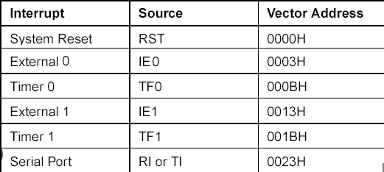
Interrupts in the 8051
Reset
Two interrupts for timers
Two external hardware interrupts
Serial communication interrupt belong to both receive and transmit

Slide 6
Interrupt Enabling and Disabling:
IE register is used for enabling and disabling the interrupt
This is a bit addressable register in which EA value must be set to one for enabling interrupts.

Slide 7
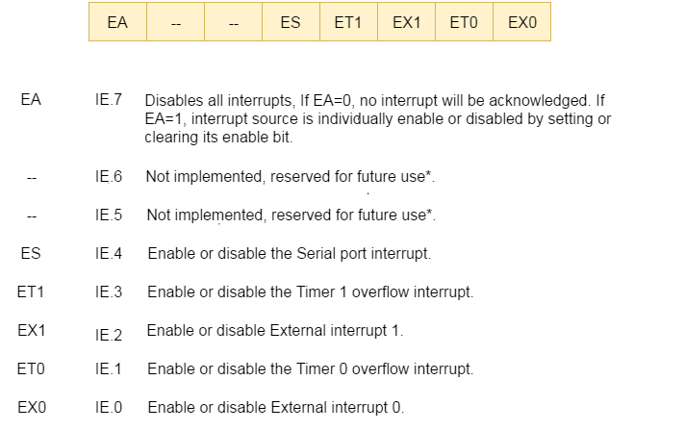

Slide 8
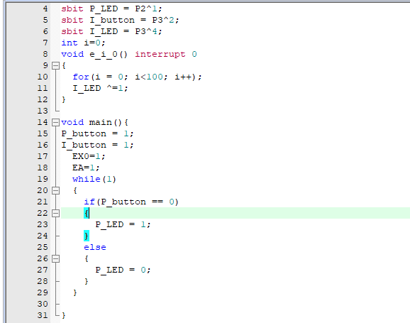

Slide 9
Task1: Run the progam given in the slides and attach both code and proteus Screen shot.
Task2:Attach 7seg-BCD with PORT1 and whenever interrupt occur at PORT3 (P3^2) display in the seven segment. On pressing the button it display 1 again pressing the button it should display 2.
Hint: Increment PORT1 when an interrupt occur

